Slide 1
Error Recovery Strategies and LR Parsing Conflicts
Lecture 10
Section 4.1.4, 4.4.5, 4.5.4
Rokan Uddin Faruqui
Associate Professor
Dept of Computer Science and Engineering University of Chittaong, Bangladesh Email: rokan@cu.ac.bd

Slide 2





Error Recovery Strategies
Error Recovery in Predictive Parsing
Shift/Reduce Conflicts
Precedence and Associativity
Assignment
Error Recovery Strategies and LR Parsing Con

Slide 3





Outline
Error Recovery Strategies
1
Error Recovery Strategies
Error Recovery in Predictive Parsing
Shift/Reduce Conflicts
4
Precedence and Associativity
5 Assignment
Error Recovery Strategies and LR Parsing Con

Slide 4
Error Recovery
Error Recovery Strategies
Once an error is detected during parsing, how should the parser recover?
Error Recovery Strategies and LR Parsing Con

Slide 5
Error Recovery
Error Recovery Strategies
Parser to quit with an informative error message when it detects the first error.
Additional errors are often uncovered
if the parser can restore itself to a state where processing of the input can continue
may provide meaningful diagnostic information.
If errors pile up, it is better for the compiler to give up
Error Recovery Strategies and LR Parsing Con

Slide 6
Error Recovery Strategies
Error Recovery Strategies
Panic Mode
Parser discards input symbols one at a time until one of a designated set of synchronizing tokens is found.
Synchronizing tokens are usually delimiters, such as ; or }, whose role in the source program is clear and unambiguous.
Phrase-Level Recovery Parser may perform local correction on the remaining input
May replace a prefix of the remaining input by some string that allows the parser to continue
A typical local correction is to replace a comma by a semicolon, delete an extraneous semicolon, or insert a missing semicolon.
Error Recovery Strategies and LR Parsing Con

Slide 7
Error Recovery Strategies
Error Recovery Strategies
E—>E+T
Error Productions By anticipating common error, grammar is augmented with productions that generate the erroneous
constructs
Parser can then generate appropriate error diagnostics about the erroneous construct that has been recognized in the input
Global Correction Given an incorrect input string x and grammar G, these algorithms will and a parse tree for a related string y, such that the number of insertions, deletions, and changes of tokens required to transform x into y is as small as possible.
Error Recovery Strategies and LR Parsing Con

Slide 8


Outline
Error Recovery in Predictive Parsing
1
Error Recovery Strategies
2 Error Recovery in Predictive Parsing
3 Shift/Reduce Conflicts
4
Precedence and Associativity
5 Assignment
Error Recovery Strategies and LR Parsing Con

Slide 9
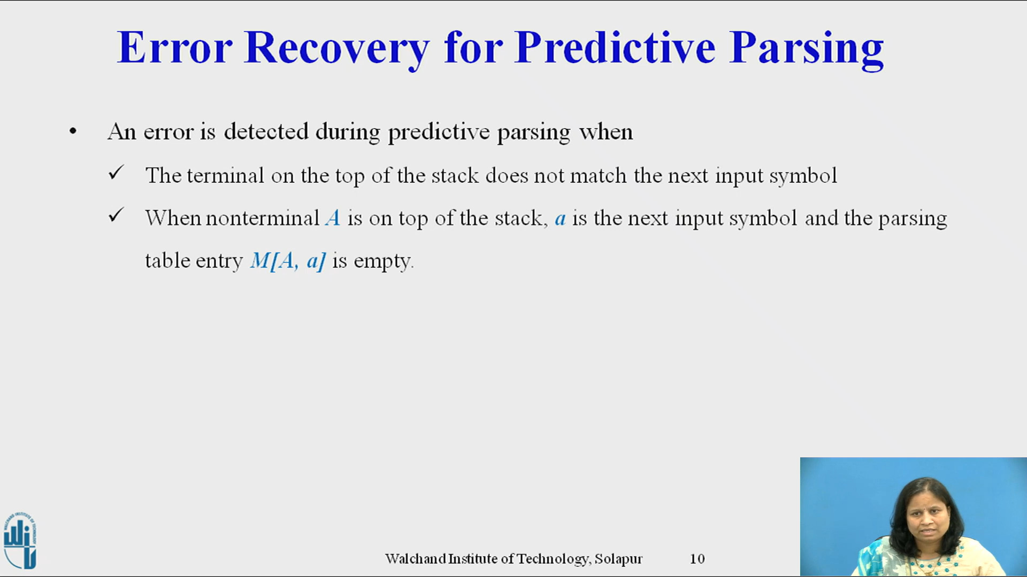

Slide 10
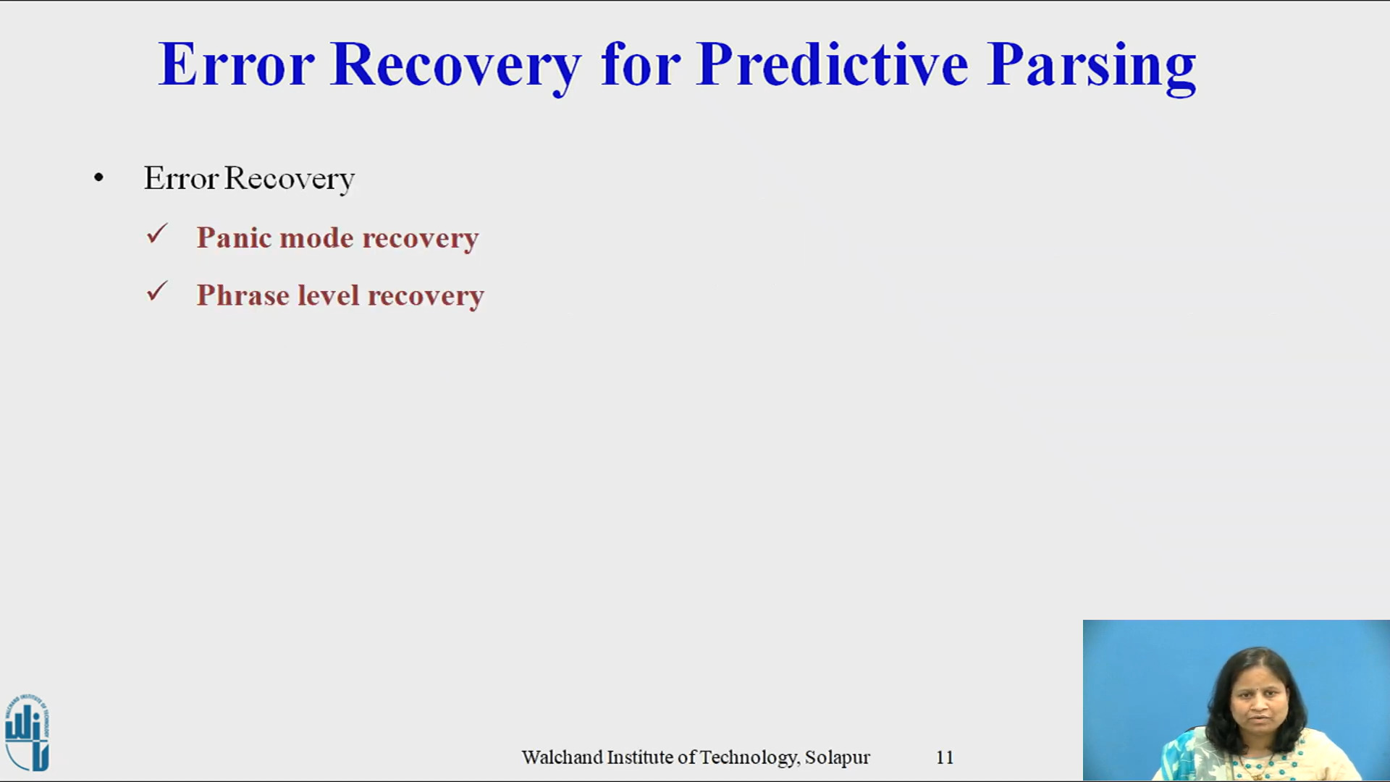

Slide 11
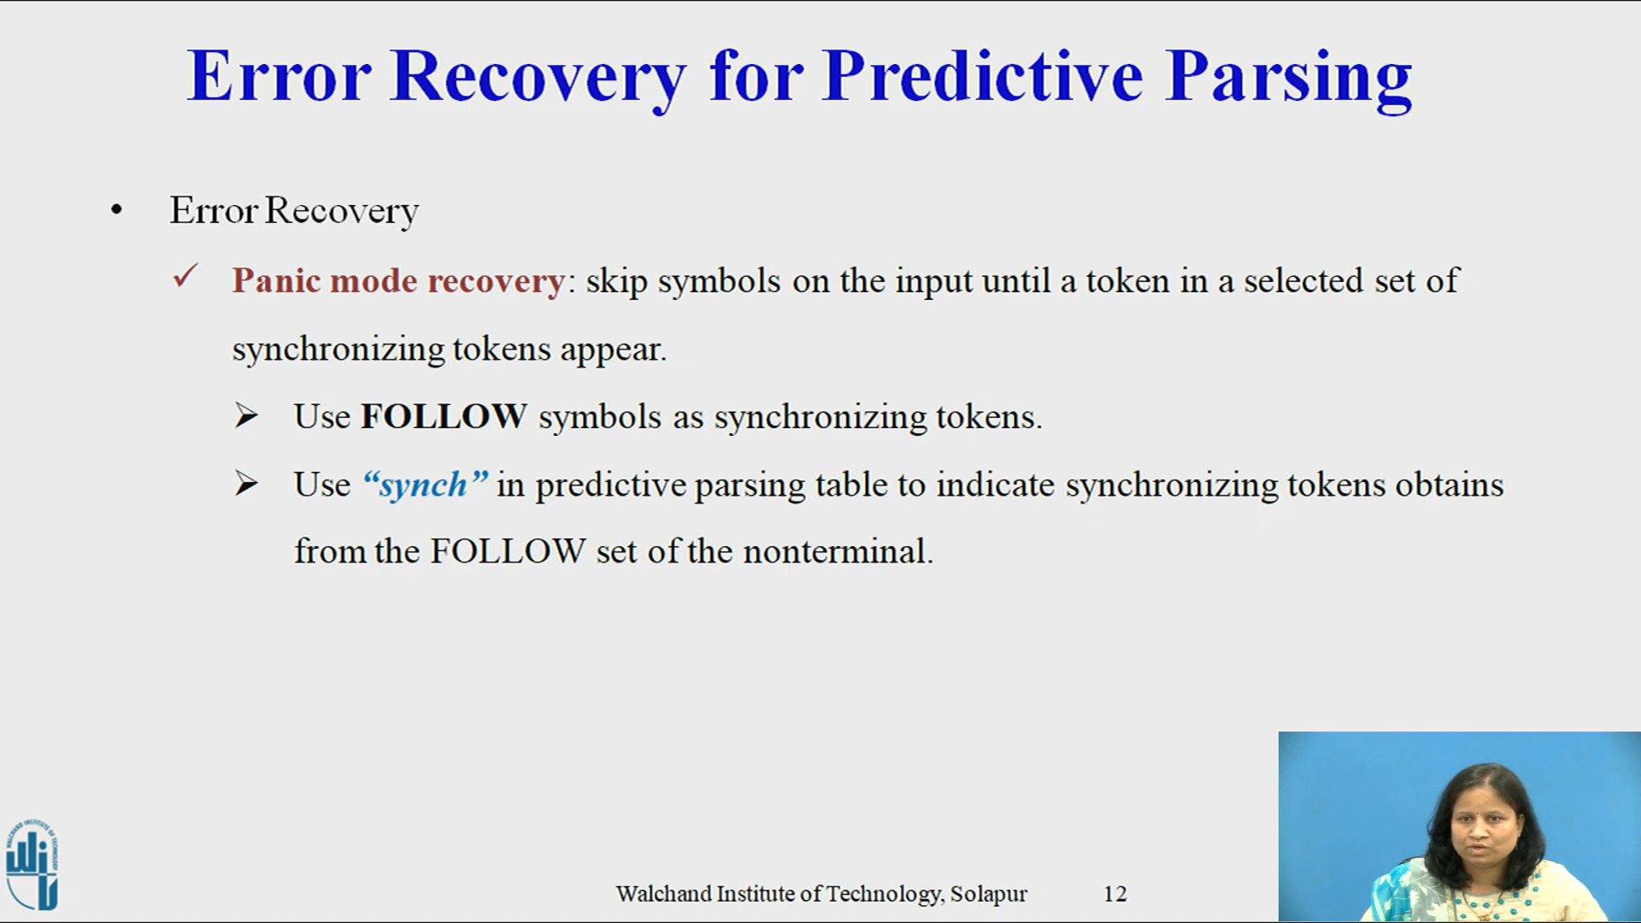

Slide 12


Slide 13
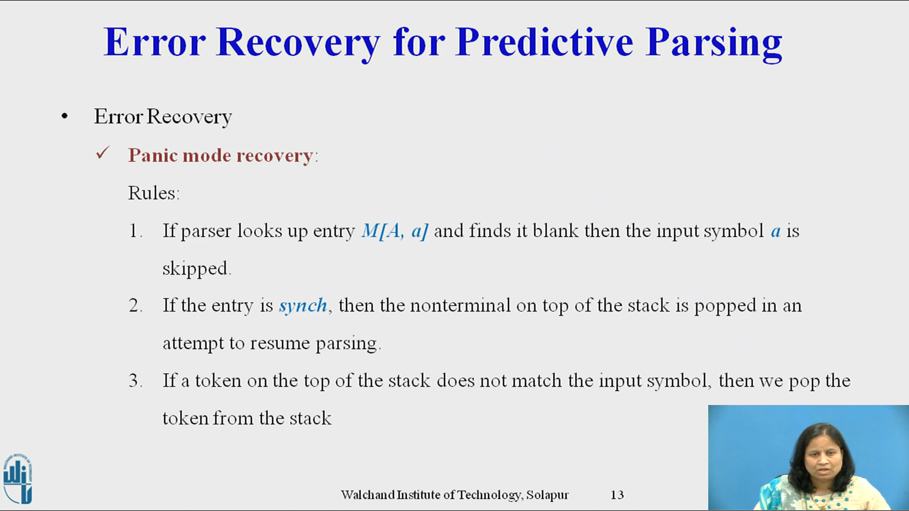

Slide 14
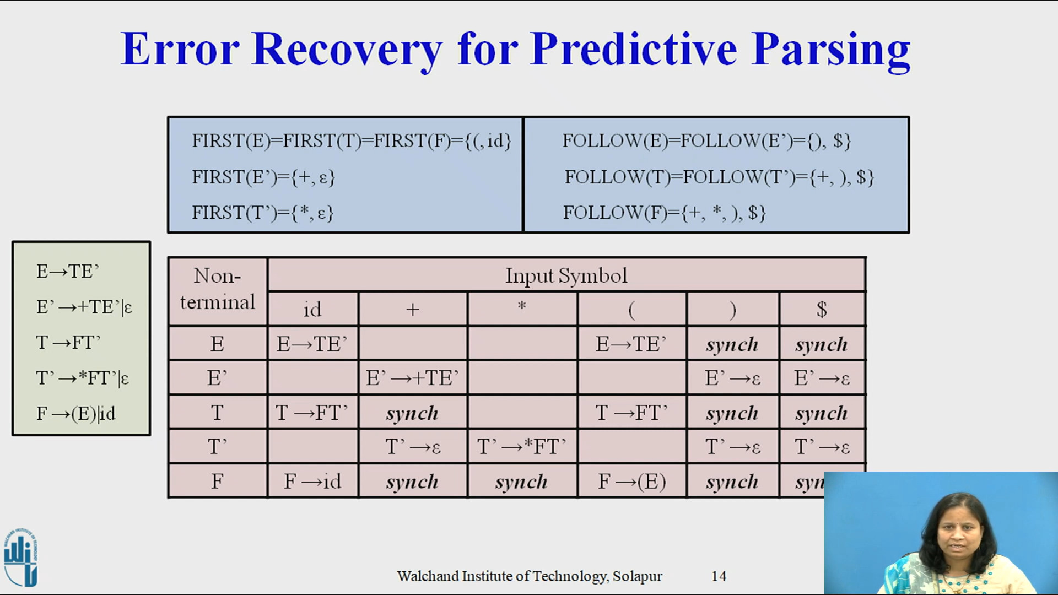

Slide 15
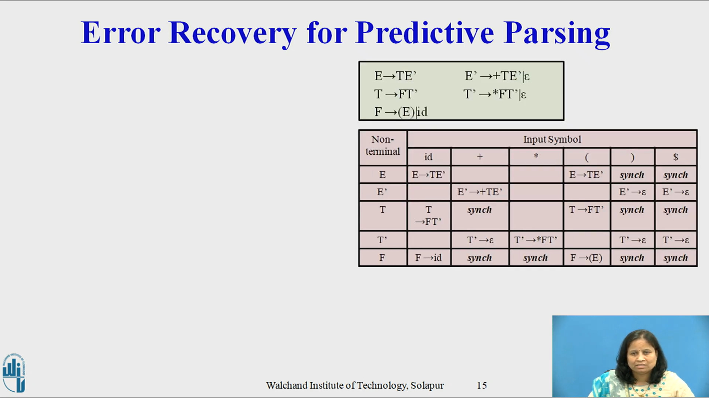

Slide 16
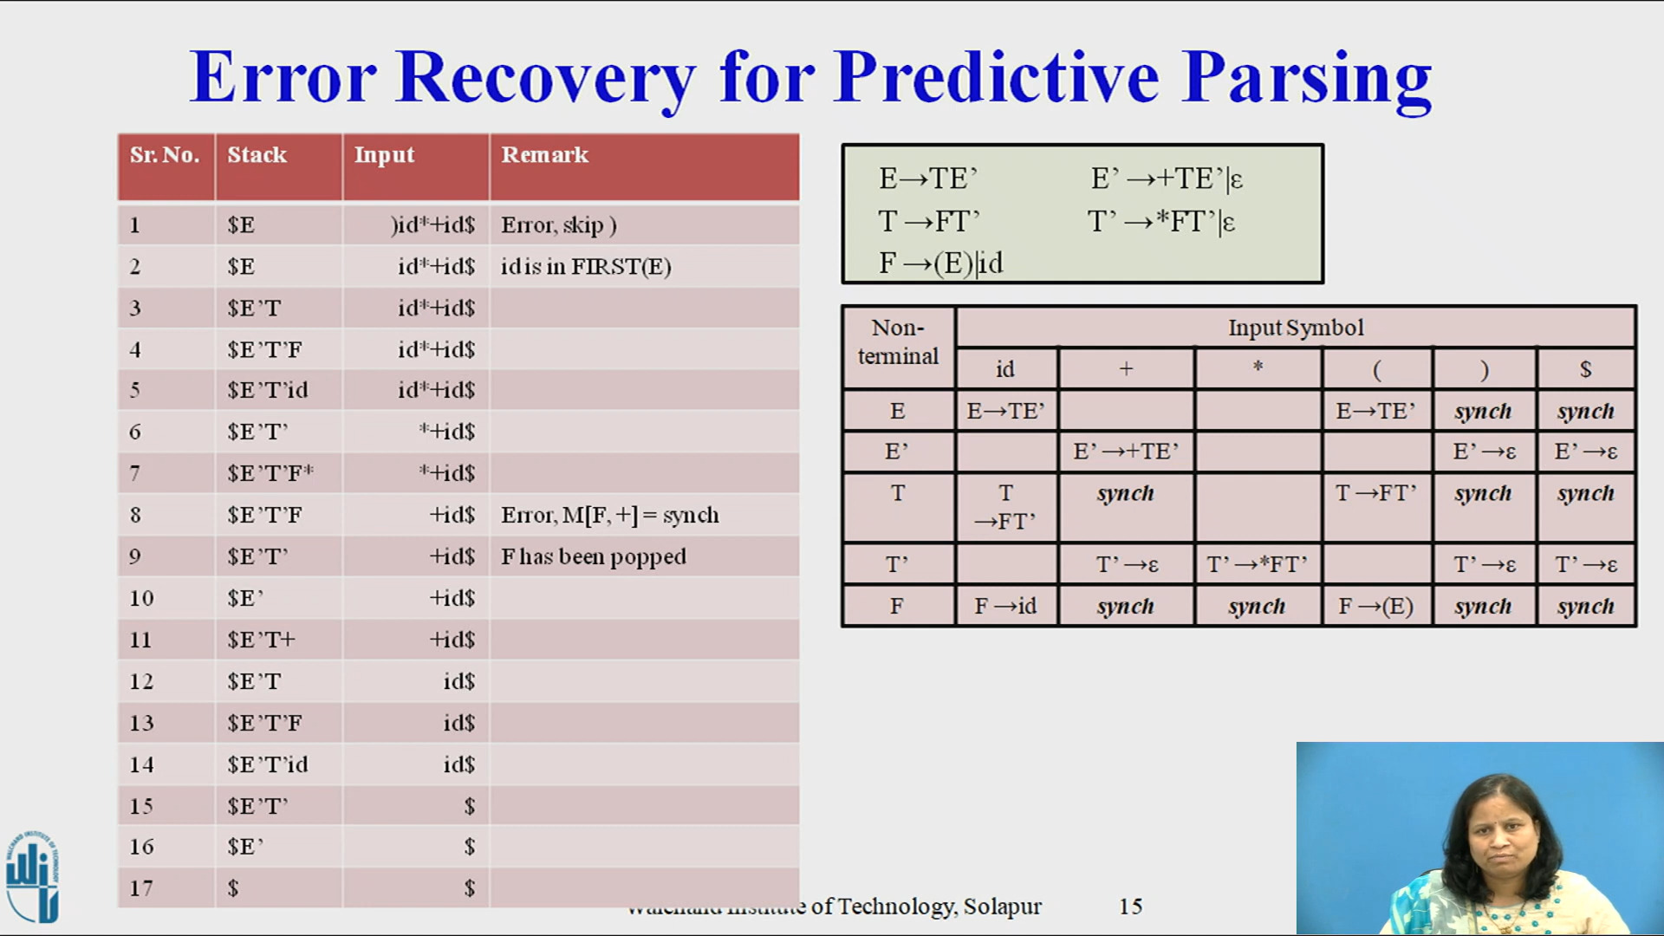

Slide 17
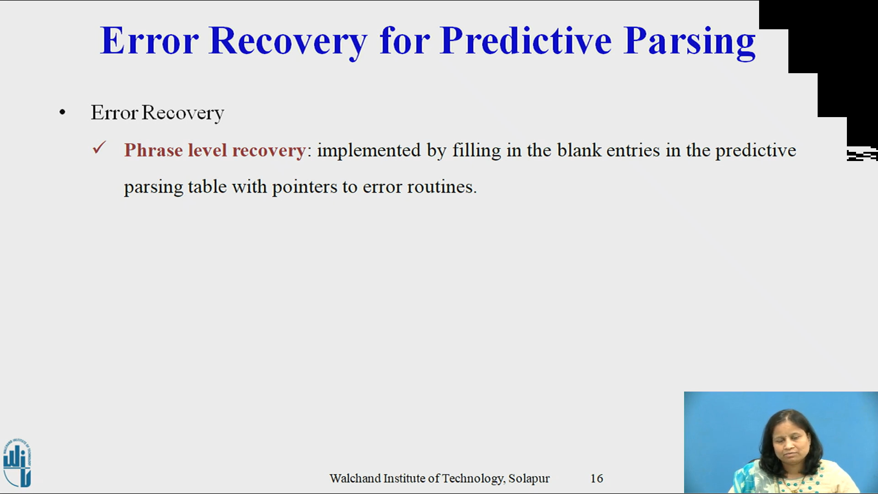

Slide 23
Error Recovery in Predictive Parsing
Error Recovery in Predictive Parsing
An error is detected during predictive parsing when the terminal on top of the stack does not match the next input symbol or when nonterminal A is on top of the stack, a is the next input symbol, and M [A; a] is error (i.e., the parsing-table entry is empty).
Error Recovery Strategies and LR Parsing Con

Slide 24
Error Recovery Strategies in Predictive Parsing
Error Recovery in Predictive Parsing
Panic Mode
1
Place all symbols in FOLLOW (A) into the synchronizing set for nonterminal A. Skip tokens until an element of FOLLOW (A) is seen and pop A from the stack.
Additional symbols such as delimiters in synchronizing set.
Add symbols in FIRST (A) to the synchronizing set for nonterminal A.
If nonterminal is nullable, then ϵ production can be uses as a default.
If a terminal on top of the stack cannot be matched, a simple idea is to pop the terminal, issue a message saying that the terminal was inserted, and continue parsing
2
3
4
5
Error Recovery Strategies and LR Parsing Con

Slide 25
Example
Error Recovery in Predictive Parsing
Example
Let the grammar be
E → T E′
E′ → + T E′ | ε T → F T ′
T ′ → * F T ′ | ε F → ( E ) | id
Error Recovery Strategies and LR Parsing Con

Slide 26
Error Recovery in Predictive Parsing
Example
Example (Parse Table) Recall
Nonterminal | Nullable | FIRST | FOLLOW
E | No | {(, id} | {$, )}
_{E}′ | Yes | {+} | {$, )}
T | No | {(, id} | {$, ), +}
_{T} ′ | Yes | {∗} | {$, ), +}
F | No | {(, id} | {∗, $, ), +}
Error Recovery Strategies and LR Parsing Con

Slide 27
Error Recovery in Predictive Parsing
Example
Example (Parse Table)
 | + | * | ( | ) | id | $
E |  |  | E → T E′ |  | E → T E′
_{E}′ | E′ → + T E′ |  |  | E′ → ε |  | E′ → ε
T |  |  | T → F T ′ |  | T → F T ′
_{T} ′ | T ′ → ε | T ′ → * F T ′ |  | T ′ → ε |  | T ′ → ε
F |  |  | F → ( E ) |  | F → id
Error Recovery Strategies and LR Parsing Con

Slide 28
Error Recovery in Predictive Parsing
Example
Example (Parse Table with Error Recovery)
 | + | * | ( | ) | id | $
E |  |  | E → T E′ | sync | E → T E′ | sync
_{E}′ | E′ → + T E′ |  |  | E′ → ε |  | E′ → ε
T | sync |  | T → F T ′ | sync | T → F T ′ | sync
_{T} ′ | T ′ → ε | T ′ → * F T ′ |  | T ′ → ε |  | T ′ → ε
F | sync | sync | F → ( E ) | sync | F → id | sync
Error Recovery Strategies and LR Parsing Con

Slide 29






























Error Recovery in Predictive Parsing
Error Recovery Strategies and LR Parsing Con

Slide 30

Outline
Shift/Reduce Conflicts
1
Error Recovery Strategies
2 Error Recovery in Predictive Parsing
3 Shift/Reduce Conflicts
4
Precedence and Associativity
5 Assignment
Error Recovery Strategies and LR Parsing Con

Slide 31
Example
Shift/Reduce Conflicts
Example (A Simplified Grammar)
We may simplify our grammar to
E → E + E
E → E * E E → ( E )
E → id
In this form, the precedence rules for + and * are not implicit. They must be incorporated into the tables.
Error Recovery Strategies and LR Parsing Con

Slide 32
Shift/Reduce Conflicts
Shift/Reduce Conflicts
It is possible that a cell will contain both a shift operation and a reduce operation.
This is called a shift/reduce conflict.
To choose between “shift” and “reduce,” each case must be considered on its own merit.
Consider the case of E → E + E | E ∗ E and the inputs
a + b * c and a * b + c.
4+5*3 => 27, 19
Error Recovery Strategies and LR Parsing Con

Slide 33
Reduce/Reduce Conflicts
Shift/Reduce Conflicts
It is possible that a cell will contain two different reduce operations.
This is called a reduce/reduce conflict.
This occurs when a sequence of tokens matches the right-hand sides of two different productions at the same time.
For each such conflict in the table, we must choose which reduction to apply.
The presence of a reduce/reduce conflict indicates that you should find another grammar.
Error Recovery Strategies and LR Parsing Con

Slide 34
Reduce/Reduce Conflicts
Shift/Reduce Conflicts
It is possible that a cell will contain two different reduce operations.
This is called a reduce/reduce conflict.
This occurs when a sequence of tokens matches the right-hand sides of two different productions at the same time.
For each such conflict in the table, we must choose which reduction to apply.
The presence of a reduce/reduce conflict indicates that you should find another grammar.
Error Recovery Strategies and LR Parsing Con

Slide 35
Shift/Reduce Conflicts
Example
Example (The Action and Goto Tables)
State | Action |  |  |  |  |  | Goto
 | + | * | ( | ) | id | $ | E
0 |  |  | s2 |  | s3 |  | 1
1 | s4 | s5 |  |  |  | acc
2 |  |  | s2 |  | s3 |  | 6
3 | r4 | r4 |  | r4 |  | r4
4 |  |  | s2 |  | s3 |  | 7
5 |  |  | s2 |  | s3 |  | 8
6 | s4 | s5 |  | s9
7 | s4/r1 | s5/r1 |  | r1 |  | r1
8 | s4/r2 | s5/r2 |  | r2 |  | r2
9 | r3 | r3 |  | r3 |  | r3
Error Recovery Strategies and LR Parsing Con

Slide 36

Outline
Precedence and Associativity
1
Error Recovery Strategies
Error Recovery in Predictive Parsing
Shift/Reduce Conflicts
4
Precedence and Associativity
5 Assignment
Error Recovery Strategies and LR Parsing Con

Slide 37
Example
Precedence and Associativity
Example (Shift/Reduce Conflicts and Associativity)
The shift/reduce conflict in cell (7, +) is between shifting a + and reducing by
E → E + E.
If we choose “shift,” then we will make addition right associative. If we choose “reduce,” then we will make addition left associative. The case is similar in cell (8, *) regarding multiplication.
Error Recovery Strategies and LR Parsing Con

Slide 38
Example
Precedence and Associativity
Example (Shift/Reduce Conflicts and Precedence)
The shift/reduce conflict in cell (8, +) is between shifting a + and reducing by
E → E * E.
4+5*5
If we choose “shift,” then we will give multiplication a higher precedence than addition.
If we choose “reduce,” then we will give addition a higher precedence than multiplication.
The case is similar in cell (7, *).
Error Recovery Strategies and LR Parsing Con

Slide 39
Precedence and Associativity
Example
Example (The Action and Goto Tables)
State | Action |  |  |  |  |  | Goto
 | + | * | ( | ) | id | $ | E
0 |  |  | s2 |  | s3 |  | 1
1 | s4 | s6 |  |  |  | acc
2 |  |  | s2 |  | s3 |  | 6
3 | r4 | r4 |  | r4 |  | r4
4 |  |  | s2 |  | s3 |  | 7
5 |  |  | s2 |  | s3 |  | 8
6 | s4 | s5 |  | s9
7 | r1 | s5 |  | r1 |  | r1
8 | r2 | r2 |  | r2 |  | r2
9 | r3 | r3 |  | r3 |  | r3
Error Recovery Strategies and LR Parsing Con

Slide 40

Outline
Assignment
1
Error Recovery Strategies
Error Recovery in Predictive Parsing
Shift/Reduce Conflicts
4
Precedence and Associativity
5 Assignment
Error Recovery Strategies and LR Parsing Con

Slide 41
Assignment
Assignment
Assignment
Let the grammar be
S → ( L ) | id
L → L , S | S
Parse the expression (id,id). (continued…)
Error Recovery Strategies and LR Parsing Con

Slide 42
Assignment
Assignment
Assignment
The grammar for if and if-else statements is
S → if ( E ) S
| if ( E ) S else S
| id = num
E → id == num
where S is a statement and E is an expression (boolean). Write the action and goto tables for this grammar.
Find the shift/reduce conflict(s) and decide how to handle them.
Error Recovery Strategies and LR Parsing Con

